Slide 1

Explainable Deep Learning for Finance
Submitted in the partial fulfillment for the award of the degree of
BACHELOR OF ENGINEERING
IN
COMPUTER SCIENCE AND BUSINESS SYSTEMS
Submitted by:
Sabhyeh Gulati- 21CBS1054
Debopriyo Nath- 21CBS1081
Under the Supervision of:
PROF. Deepak Kumar
Department of AIT-CSE
DISCOVER . LEARN . EMPOWER
1

Slide 2
Outline
Introduction and Scope of the Project
Planning to Implement
Preliminary Design of the Project
Methodology Used
Analysis of Features
2

Slide 3

Introduction to Project
In Deep learning it has emerged as a powerful tool in finance, offering the potential to analyze complex financial data efficiently. However, the lack of explainability in deep learning models poses a significant challenge for their adoption in the finance industry. This paper provides a comprehensive overview of the applications of deep learning in finance, emphasizing the importance of interpretability and transparency in financial decision-making processes. By exploring the current landscape of explainable deep learning in finance, this study aims to shed light on the advancements, challenges, and future directions in this critical intersection of technology and finance.
3

Slide 4

Scope of the Project
The project aims to develop and implement deep learning architectures for various financial prediction tasks while emphasizing interpretability. Key aspects of the project scope include:
Financial Prediction Tasks: The project will focus on tasks such as stock price prediction, market trend forecasting, and risk assessment. These tasks are crucial for financial decision-making and require accurate and interpretable models.
Data Sources: The project will utilize publicly available financial datasets from reputable sources, including stock market indices, historical stock prices and volumes, economic indicators, and news sentiment data. These datasets will provide the necessary information for training and evaluating the predictive models.
Deep Learning Architectures: The project will involve designing and implementing deep learning architectures suitable for financial prediction tasks. This may include Recurrent Neural Networks (RNNs) or Long Short-Term Memory (LSTM) networks for sequential data, Convolutional Neural Networks (CNNs) for image-based financial data, or attention mechanisms to highlight important features or time points.
4

Slide 5
Interpretability Techniques: The project will incorporate techniques to analyze and quantify the importance of input features in the financial prediction models. This includes methods such as Local Interpretable Model-agnostic Explanations (LIME), SHapley Additive exPlanations (SHAP), and gradient-based methods for feature importance. These techniques will provide insights into the decision-making process of the models and rank input features based on their impact on predictions.
Model Evaluation: The project will evaluate the performance of the deep learning models using appropriate metrics for financial prediction tasks, such as Mean Absolute Error (MAE), Mean Squared Error (MSE), and the Sharpe ratio for financial performance evaluation. Additionally, the interpretability of the models will be assessed using qualitative and quantitative measures.
By focusing on these key aspects, the project will contribute to the development of interpretable deep learning models for financial prediction tasks, providing valuable insights for decision-making in financial applications.
5

Slide 6
Methodology
Data Collection and Preprocessing:
Gather financial datasets from reputable sources.
Clean the data by handling missing values and outliers.
Perform feature engineering to create relevant features.
Model Selection and Design:
Choose deep learning architectures suitable for financial prediction tasks (e.g., LSTM, CNN).
Design models with a focus on interpretability while maintaining predictive performance.
Interpretability Techniques Integration:
Implement interpretability techniques such as LIME and SHAP.
Analyze feature importance and decision-making insights.
Model Training and Evaluation:
Train deep learning models on training data.
Validate models using appropriate metrics (e.g., MAE, MSE, Sharpe ratio).
Assess interpretability using qualitative and quantitative measures.
6

Slide 7
Documentation and Reporting:
Document methodology, including preprocessing steps, model architectures, and interpretability techniques.
Summarize findings, insights, and recommendations in a comprehensive report.
This methodology ensures a systematic approach to developing interpretable deep learning models for financial prediction tasks.
6

Slide 8
Analysis of Features:
In our methodology, we emphasize the importance of thoroughly analyzing the features used in our financial prediction models. This involves several steps:
Exploratory Data Analysis (EDA):
Before building our models, we conduct EDA to understand the characteristics and relationships among features in our dataset. This helps us identify potential patterns and outliers that may influence our predictions.
Identification of Key Features:
Through EDA and statistical analysis, we pinpoint features that exhibit strong correlations with our target variable(s) or demonstrate significant variability across the dataset. These features are considered crucial for our predictive models.
Feature Engineering:
We employ feature engineering techniques to enhance the predictive power of our models. This includes transforming existing features, creating new ones through mathematical operations or domain-specific knowledge, and selecting the most relevant features for model training.
6

Slide 9
Regarding feature updates, we adopt a dynamic approach to feature selection and engineering:
Continuous Evaluation:
We continuously monitor the relevance and performance of input features as our model evolves. This involves regularly assessing feature importance scores and model performance metrics to identify potential areas for improvement.
Adaptation to Data Changes:
As new data becomes available or the underlying data distribution changes, we update our feature engineering techniques accordingly. This ensures that our models remain robust and effective in capturing the latest trends and patterns in the data.
Incorporation of New Data Sources:
We explore the incorporation of new data sources or variables that may provide additional insights and improve the predictive capabilities of our models. This includes leveraging emerging datasets or integrating external data sources to enrich our feature space.
Through comprehensive feature analysis and continuous updates, we aim to enhance the interpretability and predictive performance of our deep learning models for financial prediction tasks.
6

Slide 10
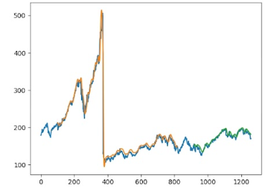
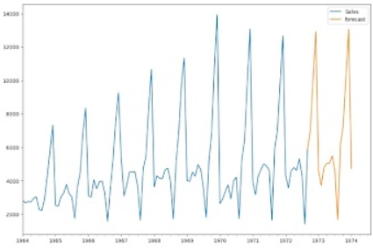
Preliminary Design of the Project
Fig-1 (LSTM)
Fig-2 (ARIMA)
7

